Slide 1

6th Grade Accelerated Math
Unit 2, Lesson 2 Equivalent Conversions: Fractions ↔ Percentages – Part 1 Volume 1, pg. 47

Slide 2


Benchmark
MA.6.NSO.3.5
Rewrite positive rational numbers in different but equivalent forms including fractions, terminating decimals, and percentages.
volume 1, pg. 47

Slide 3
Integrated Mathematical Thinking and Reasoning Standards
MA.K12.MTR.2.1 Demonstrate understanding by representing problems in multiple ways.
MA.K12.MTR.3.1 Complete tasks with mathematical fluency.
volume 1, pg. 47

Slide 4

Learning Targets
I can convert between fractions with denominators of and percentages.
I can convert between fractions and percentages using equivalent fractions.
volume 1, pg. 47

Slide 5

Warm-Up
volume 1, pg. 47

Slide 6

2.2.1 Warm-Up: A Brief History of Numerical Systems
Humans went from using body parts, tally marks, and symbols to count objects, to what we now know as the base-ten system. The base-ten system was perfected by eighth century Indian mathematicians. They realized that they could combine the Mayan creation of “zero” with a positional system that used repeatable symbols, whose values are determined by their position in a sequence. A base of ten was selected because, quite simply, we have ten fingers. Centuries later, this Hindu-Arabic numeral system began to spread to Europe
and replaced the Roman numeral system. This is
what we use today.
volume 1, pg. 47

Slide 7
What is the historical importance of the number zero?
If zero was never created, how would that affect how we do math today?
volume 1, pg. 47

Slide 8

Guided Instruction
volume 1, pg. 48

Slide 9
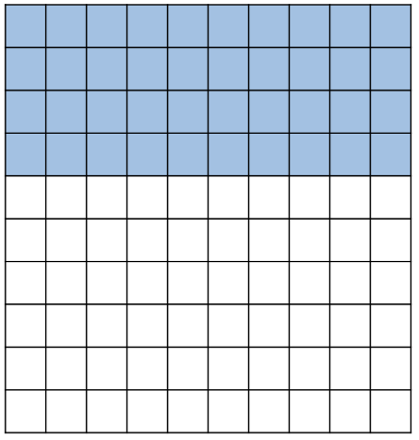

2.2.2 Guided Instruction: Converting Between Fractions and Percentages
The model represents a numerical value. Use the model to answer the questions that follow.
How many total squares are in the
image?
How many of the squares are
shaded blue?
What numerical value does the
model represent, expressed
as a fraction of ?
volume 1, pg. 48

Slide 10
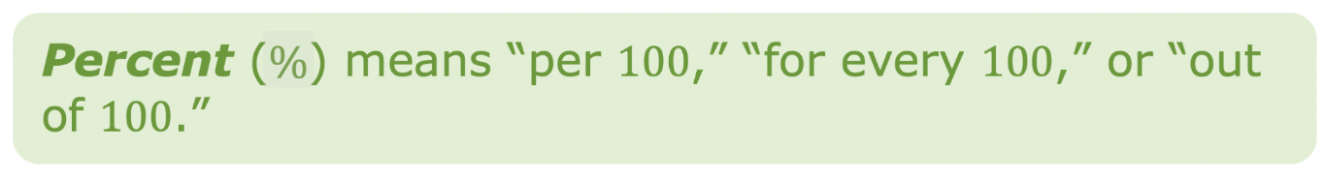

Recall that a percentage is a ratio expressed as a fraction of 100.
For example, 40% means “40 out of 100,” so 40% is equivalent to the fraction .
volume 1, pg. 48

Slide 11

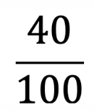
What decimal value has the same value as 40% and ?
Equivalent Values
Percent Form | Fraction Form | Decimal Form
40%
volume 1, pg. 48

Slide 12
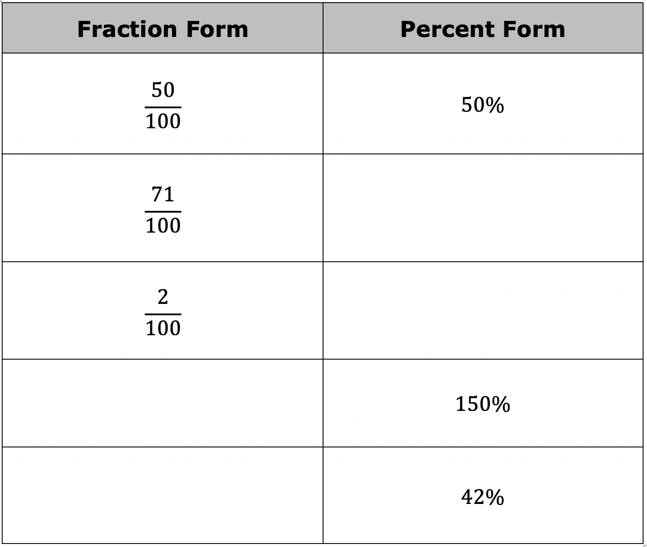
With your partner, complete the table by rewriting each value in the equivalent form indicated.
volume 1, pg. 48

Slide 13
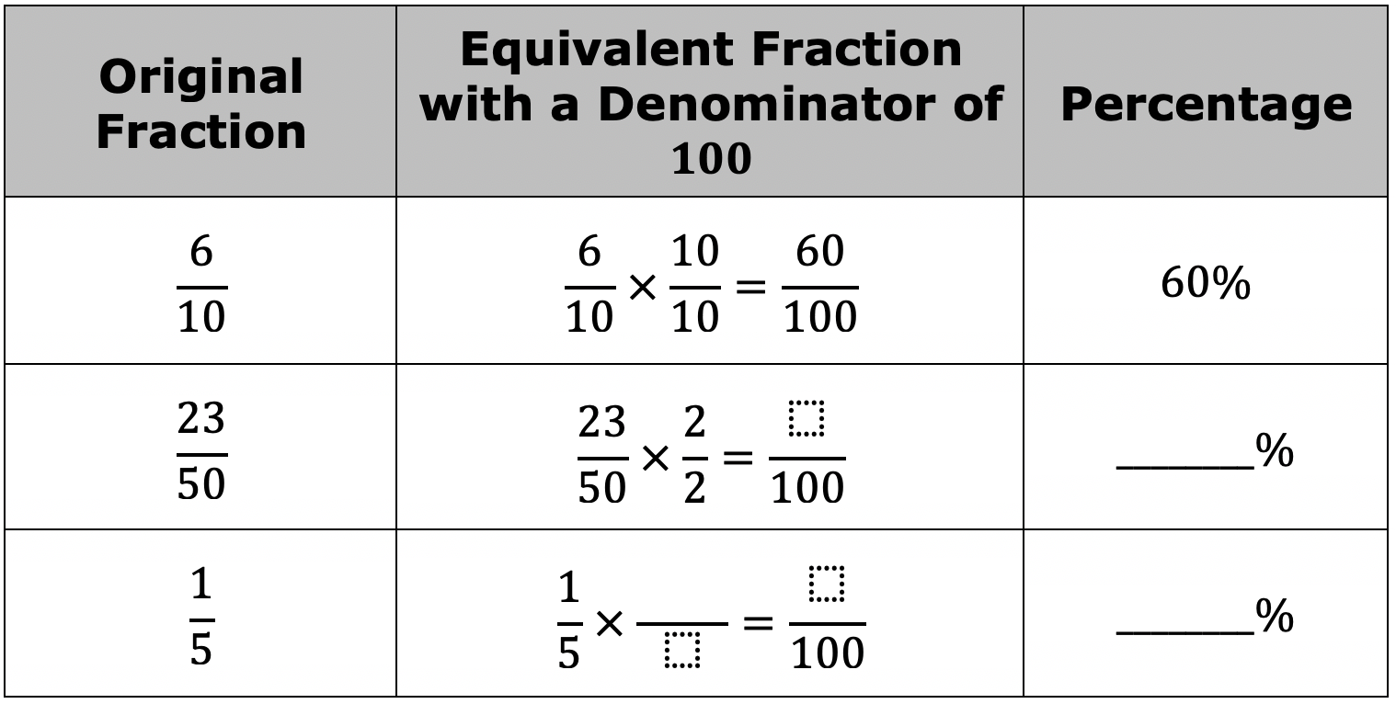
When converting fractions to percentages, generate an equivalent fraction with a denominator of 100 when possible.
Complete the table.
volume 1, pg. 49

Slide 14

Guided Practice
volume 1, pg. 49

Slide 15

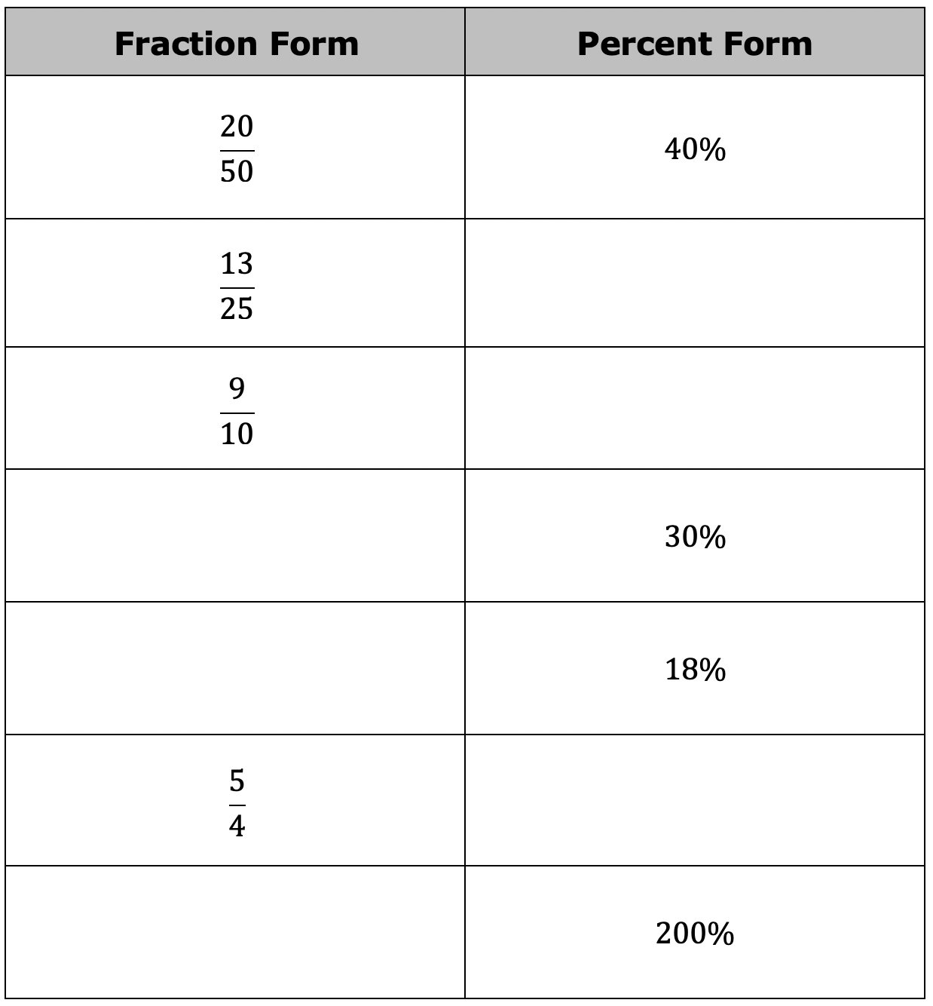
2.2.3 Guided Practice: Converting Between Fractions and Percentages
Complete the table by rewriting each value in the equivalent form indicated. Simplify where applicable.
volume 1, pg. 49

Slide 16

Your Turn
volume 1, pg. 50

Slide 17
2.2.4 Your Turn!
Rewrite each fraction as an equivalent percentage.
volume 1, pg. 50

Slide 18
Convert each to a fraction. Simplify where applicable.
volume 1, pg. 50

Slide 19

Wrap-Up
volume 1, pg. 51

Slide 20
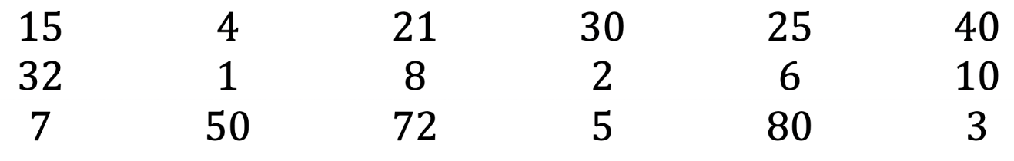
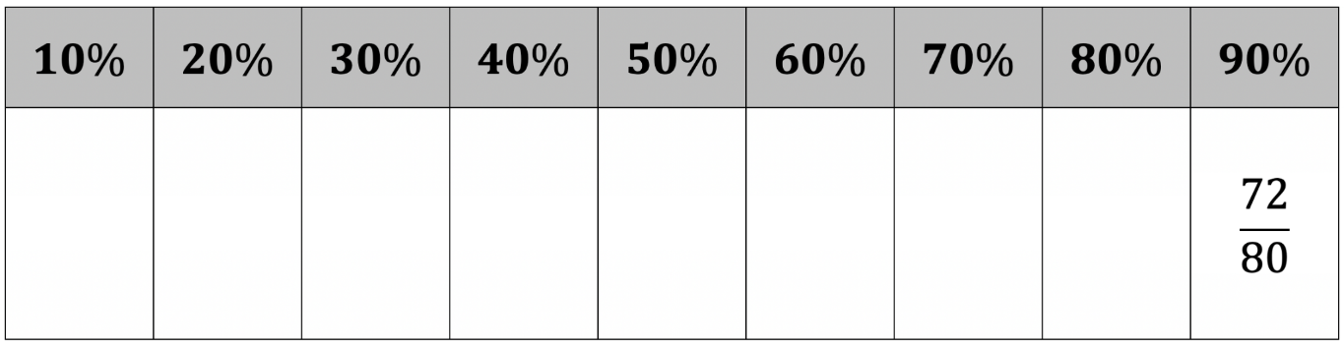
2.2.5 Wrap-Up: Ticket Out the Door
Use the numbers below to create three more fractions equivalent to any three percentages in the table.
volume 1, pg. 51

